Slide 1
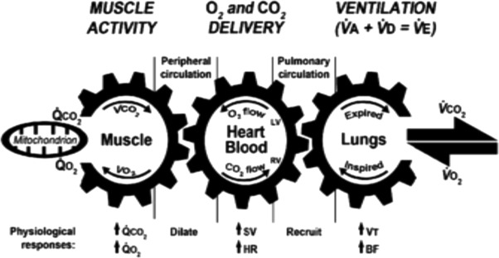
The PaCO2¹, the pH², and why they are what they are^{3,4}
1. Hypercapnic respiratory failure.
2. Describing the clinical course
3. Describing the causes
4. Describing what happens when CO2 regulation goes amiss.
Brian Locke. Research in Progress Fall 2021

Slide 2
Team:
Krishna Sundar, MD – PCCM
Ram Gouripeddi, MBBS – Bioinformatics
Jeanette Brown, MD PhD – PCCM
Conrad Addison, MD – Fellow, Sleep Medicine
Somya Mishra, MD – Resident, Anesthesia
Acknowledgement – Scott Aberegg, MD MPH; Karl Sanders MD, Rob Paine, MD

Slide 3

Goals:
I hope to convince you that the clinical epidemiology of hypercapnia needs further characterization
Project: Ways of identifying patients with hypercapnic respiratory failure in EMR data
Next steps
Notes:
[ ] retool these with minimization of physiology

Slide 4

About the PaCO2

Slide 5
Hypercapnia nosology
Acute Hypercapnic Respiratory Failure
Normalization of Hypercapnia
Acute Hypercapnic Respiratory Failure
Stability
Chronic Hypercapnic Respiratory Failure
Stability
Acute Hypercapnic Respiratory Failure
Recurrent Acute Hypercapnic Respiratory Failure
Chronic Hypercapnic Respiratory Failure (Acute Presentation)
Chronic Hypercapnic Respiratory Failure (Stable Presentation)
Notes:
Acute Hypercapnia well tolerated, much research into acute management exists
For COPD – Green vs brick arrows … in HOT-HMV, roughly ¼ of patients who met inclusion criteria at discharge were no longer hypercapnic after 2-4 weeks. Not known how frequently resolution is for other causes
For OHS overall, roughly 50/50 present as the green arrow and the yellow arrow. The green arrow has a much worse prognosis than the yellow arrow.
In UT, for reasons I’ll talk about, I expect that the green arrow is much more common than the yellow arrow, but this is not known.
Interventions I’m talking about focus on the highlighted box. Almost nothing is known about the brick line.

Slide 6
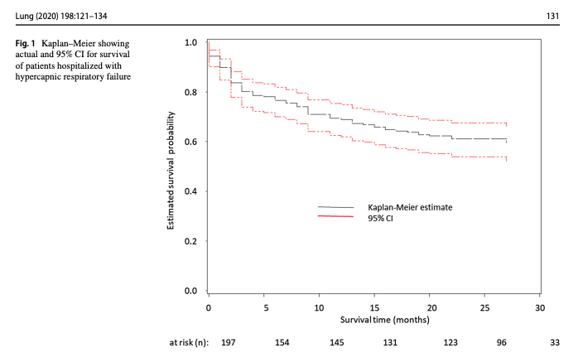
Notes:
ICD 10 diagnostic codes [J96.02 (acute HRF), J96.22 (acute and chronic respiratory failure with hypercapnia), J96.92 (respiratory failure unspecifed with hypercapnia), J96.12 (chronic respiratory failure with hypercapnia), E66.2 (morbid obesity with hypoventilation)]
https://link.springer.com/content/pdf/10.1007/s00408-019-00300-w.pdf UVM
202 patients admitted with acute hypercapneic resp failure
Identified by ICD code.
Comorbs: 29% CHF, 24% OSA, 6% OHS, 46% COPD, 10% Asthma
Admission reason: 50% resp failure, 11% pneumonia, 23% AECOPD, 5% overdose, 12% sepsis, 29% cardiac disease
23% readmission within 30 days; higher with peripheral vascular disease, active smoking, ILD and Bronchiectasis; increased with compensation (bicarb 40-49 vs 20-29)

Slide 7
Notes:
Inclusion criteria: Admitted, 18+
ABG showing PaCO2 over 45 and pH 7.35-7.45 during 2018. N=491
44% had multiple admissions w/n the year
44.2% mortality over a median of 592 days
Manual review of 40 patients with 0 competing metabolic proceses.

Slide 8
1970s vs 2010s
Notes:
If you ask medical students on service to enumerate causes of hypercapnia - they would probably say COPD, Opiate use, … neuromuscular disease, OHS, maybe thoracic restriction if they are really smart.
Not much update since 1970 (first I could find).
None of these include frequencies.

Slide 9
Obesity rates: 1990 - 2030 (predicted)
Notes:
https://www.ajpmonline.org/article/S0749-3797(12)00146-8/fulltext

Slide 11
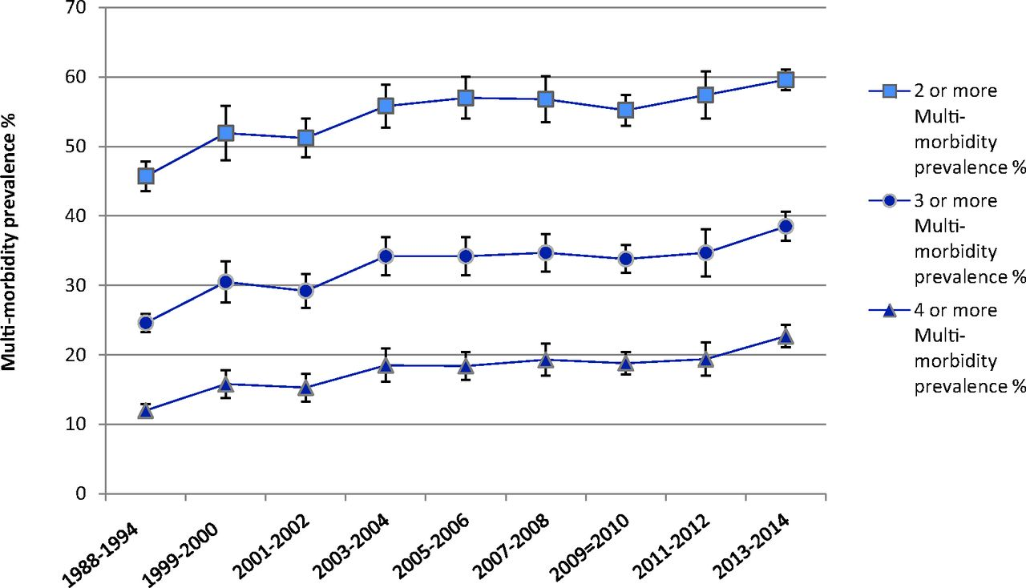
Notes:
Kane SP. Loop Diuretic, ClinCalc DrugStats Database, Version 2021.10. ClinCalc: https://clincalc.com/DrugStats/Drugs/LoopDiuretic. Updated September 15, 2021. Accessed September 21, 2021.
Multimorbidity - https://www.jabfm.org/content/31/4/503
Multimorbidity – 2 or more chronic conditions

Slide 12
Overall prevalence of OSA ( AHI > 30 ) in survivors over 50%
Notes:
Admitted to ICU to 1 ICU in Tunisia 2015-2018, PaCO2 > 6kpa = 45 mmHg, pH < 7.35. No prior OSA syndrome diagnosis.
make the point that the reverse probabilities are difficult to reason about: likelihood of a given person with OSA needing ICU care? Low. Likelihood of a given person needing ICU care having OSA? High (if that ~50% study is to be believed, severe OSA = at least 10 fold increase)
Is 50% beyond the treatment threshold for CPAP?

Slide 13
Notes:
More people who have compensated hypercapnia have CHF than COPD!

Slide 14
Notes:
Thus, risk of hypercapnia given that you have CHF > risk of hypercapnia given you have COPD or OSA
CHF = https://pubmed.ncbi.nlm.nih.gov/31992061/
COPD = https://pubmed.ncbi.nlm.nih.gov/23169314/
OSA = https://pubmed.ncbi.nlm.nih.gov/8464434/

Slide 15
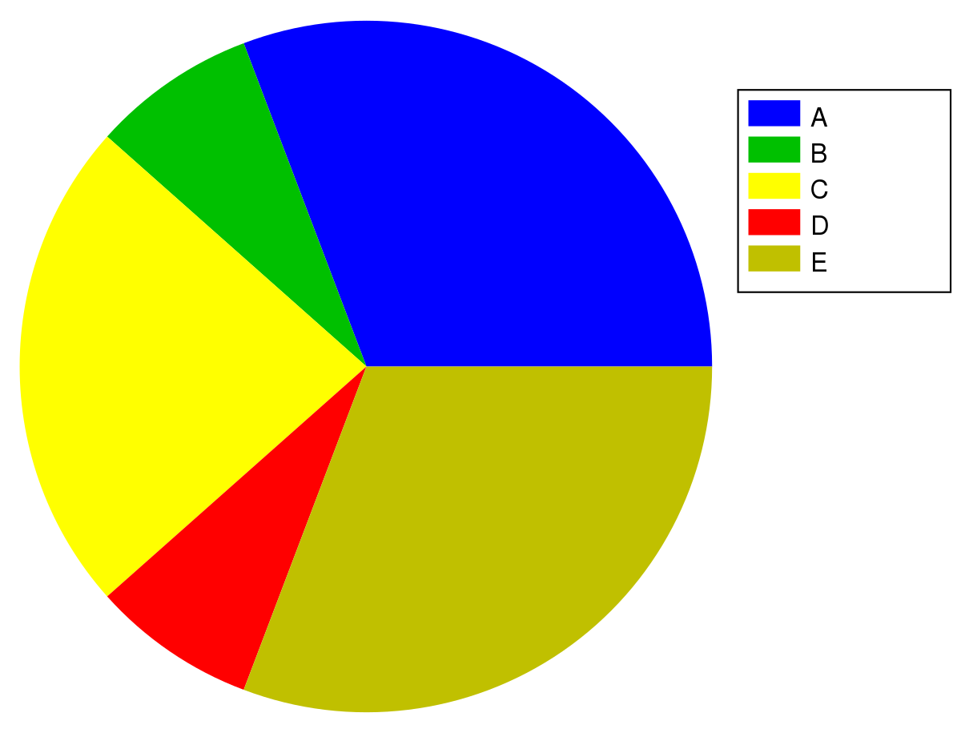
1. Theoretical distribution of causes of hypercapnic respiratory failure
Weak testing evidence required
Strong testing evidence required
Diagnosis
Prevalence Estimates (USA):
CHF: AHA estimate = 1.8%
COPD: CDC estimate = 6.3%.
OSA w/ AHI over 15: 7% (Wisconsin Sleep Cohort Study)
2. Conditional probabilities:
P (Hypercapnic Resp Failure | Condition) = P ( HRF and condition) / P (Condition)

Slide 16
Causal? Associated?
If we improve hypercapnia without improving the cause, do we improve outcomes?
Notes:
Talk about the two ways patients are identified (ICU, vs sleep/pulm) and their difference

Slide 17

Say you get the cause right.. now what?
Cause | Treatment | Outcome Improved | LOE (Cochrane or ATS) | Criteria (*Resmed)
Restrictive Thoracic Dz | NIV | Hospitalization, Mortality | Meta-analysis of 3+ 3(mixed) RCTs Low | ABG w/ PaCO2 over 45 Sleep oximetry SpO2 < 88%
OHS | CPAP or BiPAP | CO2, O2, ED visits, and mortality. | Meta-analysis of 3 RCTs and 12 nonrandomized studies | CPAP: Sleep study BiPAP: PaCO2 awake > 45 mmHg and FEV1 > FVC 70%
COPD | NIV | CO2 Hospitalization, QOL, dyspnea | Meta-analysis of 14 RCTs Moderate | PaCO2 over 45 or 52 Sleep oximetry SpO2 < 5 mintues on 2L or usual O2 OSA excluded or CPAP tried 2-4 weeks recovery from exac.
Neuromuscular Dz |  | Hospitalization, Mortality | Meta-analysis of 4+3 (mixed) RCTs Low | ABG w/ PaCO2 over 45 Sleep oximetry SpO2 < 88% MIP < 60cmH2o or FVC < 50%
Notes:
COPD https://www.atsjournals.org/doi/full/10.1164/rccm.202006-2382ST
OHS: https://pubmed.ncbi.nlm.nih.gov/31726017/
Neuromuscular and chest D/O https://pubmed.ncbi.nlm.nih.gov/25503955/
https://document.resmed.com/documents/articles/1010293_RAD_Guidelines.pdf
What percentage of people who come in to the ICU meet those criteria?
Logistical problems: how many people get assessed if they do?
What other options are there? Pharm, etc.
GDMT
Compare to decompensated heart failure or decompensated heart failure
In a way, this is decompensated pulmonary failure.

Slide 18
What is the opportunity?
Two ways you can address hypercapnia:
Fix can’t breathe
NIV. ← Data here
ONLY limited subset with chronic hypercapnia. Not recurrent acute hypercapnia
Addressing strength (Pulm Rehab?)
Reversing cause (Weight loss?)
Fix won’t breathe
Reduce medications that decrease hypercapnic ventilatory response
Increase hypercapnic ventilatory response (acetazolamide)
What do you do on discharge, if anything?

Slide 19
General hypotheses regarding hypercapnia
The causes of hypercapnia have changed due to increased rates of obesity, opiate use, and multimorbidity (e.g. CHF+Loop diuretics)
OSA (OHS, or not); CHF/Diuretics are major drivers.
More than COPD and NMD
Both the presence of hypercapnia and the cause of hypercapnia are frequently missed. Management that could be instituted is not. Outcomes suffer as a result
There is little evidence to guide the management of these patients, partly due to suboptimal disease classification and partly due to absence of adequate investigation.
So… where do we start?
Notes:
Proposal is to impact the OUTPATIENT management of these patient who present as INPATIENT

Slide 20
Step 1: Who is the source population?
Definition of Respiratory Failure (Nunn and Lamb’s Applied Respiratory Physiology, 9th Edition):
“Failure of maintenance of normal arterial gas partial pressures”
Normal (sea level) 95% range 38.3 +/- 7.5 mmHg => 45 mmHg threshold.
Who meets these criteria?

Slide 21
Admitted (ICU or floor) with one of the following diagnostic codes:
J96.02 (acute hypercapnic respiratory failure)
J96.22 (acute and chronic respiratory failure with hypercapnia)
J96.92 (respiratory failure unspecifed with hypercapnia)
J96.12 (chronic respiratory failure with hypercapnia)
E66.2 (morbid obesity with hypoventilation)
Notes:
ICD 10 diagnostic codes [J96.02 (acute HRF), J96.22 (acute and chronic respiratory failure with hypercapnia), J96.92 (respiratory failure unspecifed with hypercapnia), J96.12 (chronic respiratory failure with hypercapnia), E66.2 (morbid obesity with hypoventilation)]
https://link.springer.com/content/pdf/10.1007/s00408-019-00300-w.pdf UVM
202 patients admitted with acute hypercapneic resp failure
Identified by ICD code.
Comorbs: 29% CHF, 24% OSA, 6% OHS, 46% COPD, 10% Asthma
Admission reason: 50% resp failure, 11% pneumonia, 23% AECOPD, 5% overdose, 12% sepsis, 29% cardiac disease
23% readmission within 30 days; higher with peripheral vascular disease, active smoking, ILD and Bronchiectasis; increased with compensation (bicarb 40-49 vs 20-29)

Slide 22
Admitted to ICU with PaCO2 over 45 mmHg and a pH less than 7.35
Notes:
Admitted to ICU to 1 ICU in Tunisia 2015-2018, PaCO2 > 6kpa = 45 mmHg, pH < 7.35. No prior OSA syndrome diagnosis.
make the point that the reverse probabilities are difficult to reason about: likelihood of a given person with OSA needing ICU care? Low. Likelihood of a given person needing ICU care having OSA? High (if that ~50% study is to be believed, severe OSA = at least 10 fold increase)
Is 50% beyond the treatment threshold for CPAP?

Slide 23
Admitted to hospital (Floor or ICU) with ABG showing PaCO2 over 45 mmHg and pH 7.35-7.45
Notes:
More people who have compensated hypercapnia have CHF than COPD!

Slide 24
Admitted to the ICU
PaCO2 greater than 47.25 mmHg
Procedure code for non-invasive ventilation or invasive mechanical ventilation initiation
Notes:
N=78 patients, consecutive; 1 center Geneva, 2012. Recruited at ICU discharge after surviving: primary admission for Resp failure, PaCO2 over 6.3 kpa and requiring invasive or NIV. Exclude NM dz, iatrogenic, or with persisting confusion
21% had been hospitalized in the last yr for resp failure. 67% had COPD. 81 percent of patients without COPD were obese. 29% had OSA known (mostly untreated); 66% of those tested had mod-severe OSA. 51% had COPD&OSA. 44% had HFpEF, ~16%ish had pHTN

Slide 25
Hypotheses:
The various methods used in studies of hypercapnic respiratory failure identify different patients
Hypothesis 1: the sensitivity (aka recall) and positive predictive value (aka precision) for both billing code- and procedural code-based identification of hypercapnic respiratory failure will be below 80%, when compared to blood gas-based identification as the reference standard.
These populations differ in risk for outcomes of interest which hampers interpretation of these studies.
Hypothesis 2: The distribution of age, ethnicity, BMI, Elixhauser comorbidity score, and frequency of coexisting diagnoses (OSA, opiate use disorder, COPD, CHF, and neuromuscular disease) will differ between the cohorts identified by each method.
Notes:
Will discuss why not Se and Sp
Will discuss why blood gas taken as a reference standard.
Hypothesis 2: The distribution of age, ethnicity, BMI, Elixhauser comorbidity score, and frequency of coexisting diagnoses (OSA, opiate use disorder, COPD, CHF, and neuromuscular disease) will differ between the cohorts identified by each method.

Slide 26
Data source:

Slide 27
Data source:
69 million MRNs; ~50 academic medical centers (including U of U)
De-identified, patient-level data (not PHI, though recommended to be treated as such)
Data Available | Data unavailable
Demographics Diagnosis Medications Procedures - what procedures were done. E.g. sleep study code Labs Cancer registry (NAACCR) Allergies | Some notes* Diagnostic reports DICOM image objects Providers Departments/clinics

Slide 28
Data request:
69 million MRNs; ~50 academic medical centers (including U of U)
De-identified data (not PHI, though recommended to be treated as such)
Cannot be geolocated or tracked to a specific center

Slide 29
Data request:
69 million MRNs; ~50 academic medical centers (including U of U)
De-identified data (not PHI, though recommended to be treated as such)
Cannot be geolocated or tracked to a specific center

Slide 33
We requested patient level data from all records with an inpatient encounter and any of:
Diagnostic code for respiratory failure
Included all types
Arterial Blood gas with hypercapnia (45 mmHg+)
Procedure code for initiation or management of NIV or IMV
N=~800,000 patients.
Notes:
(bolded = correct classifications for hypercapnia; non-bolded = incorrect, but likely common, misclassifications of hypercapnia)
J96.12 (chronic respiratory failure with hypercapnia),
J96.02 (acute hypercapneic respiratory failure),
J96.22 (acute and chronic respiratory failure with hypercapnia),
J96.92 (respiratory failure unspecified with hypercapnia),
E66.2 (morbid obesity with hypoventilation)
J96 Respiratory Failure, not otherwise specified
J96.00 Acute Respiratory Failure, unspecified whether hypoxia or hypercapnia
J96.01 Acute respiratory failure, with hypoxia
J96.1 Chronic Respiratory Failure
J96.10 Chronic Respiratory Failure, unspecified whether hypoxia or hypercapnia J96.11 Chronic Respiratory Failure with hypoxia
J96.2 Acute and Chronic Respiratory Failure
J96.20 Acute and Chronic Respiratory Failure, unspecified whether hypoxia or hypercapnia
J96.21 Acute and Chronic Respiratory Failure, with hypoxia
J96.90 Respiratory Failure, unspecified whether with hypoxia or hypercapnia (most common in TrinetX)
J96.91 Respiratory Failure, unspecified with hypoxia
Specific Procedure Codes:
Assistance with Respiratory Ventilation, 0-24 hours; 24-96 hours; and longer than 96 hours
Management of non-invasive ventilation
Respiratory Ventilation, 0-24 hours; 24-96 hours; and longer than 96 hours
Ventilator Management
Ventilation Assist and Management.. initial; first day; and subsequent day
ICD-10: Mechanical Ventilation - 5A1935Z, 5A1945Z, 5A1955Z
Specific Blood gas codes:
LOINC 2019-8 Carbon Dioxide [ Partial Pressure ] Arterial Blood over 45
LOINC 2026-3 Carbon Dioxide, total [ Moles/Volume] in Arterial Blood over 45
LOINC 32771-8 Carbon Dioxide [ Partial Pressure] adjusted to patient’s actual temperature in arterial blood over 45
LOINC 11557-6 Carbon Dioxide [ Partial Pressure] in Blood

Slide 35
Statistical Analysis Plan: why not Se/Sp?
Example Calculation | ICD code = ‘Prediction’ | ICD code = ‘Prediction’
Blood gas = reference standard |  | ICD Code for Hypercapnic RF | No ICD code for Hypercapnic RF
Blood gas = reference standard | PaCO2 >= 45mmHg | True Positive | False Negative | Sensitivity TP / (TP + FN)
 | PaCO2 < 45mmHg (or no ABG) | False Positive | True Negative [We will not have these] | Specificity TN / (TN + FP)
 |  | PPV TP / (TP + FP) | NPV TN / (TN + FN)
Notes:
Sensitivity = aka recall
PPV = aka precision
Respiratory failure – “failure to maintain appropriate partial pressures of oxygen in the alveoli [?]” – vs arterial blood gasses

Slide 36
Statistical Analysis Plan: why ABG as ref std?
Example Calculation | ICD code = ‘Prediction’ | ICD code = ‘Prediction’
Blood gas = reference standard |  | ICD Code for Hypercapnic RF | No ICD code for Hypercapnic RF
Blood gas = reference standard | PaCO2 >= 45mmHg | True Positive | False Negative | Sensitivity TP / (TP + FN)
 | PaCO2 < 45mmHg (or no ABG) | False Positive | True Negative [We will not have these] | Specificity TN / (TN + FP)
 |  | PPV TP / (TP + FP) | NPV TN / (TN + FN)
Notes:
Sensitivity = aka recall
PPV = aka precision

Slide 37
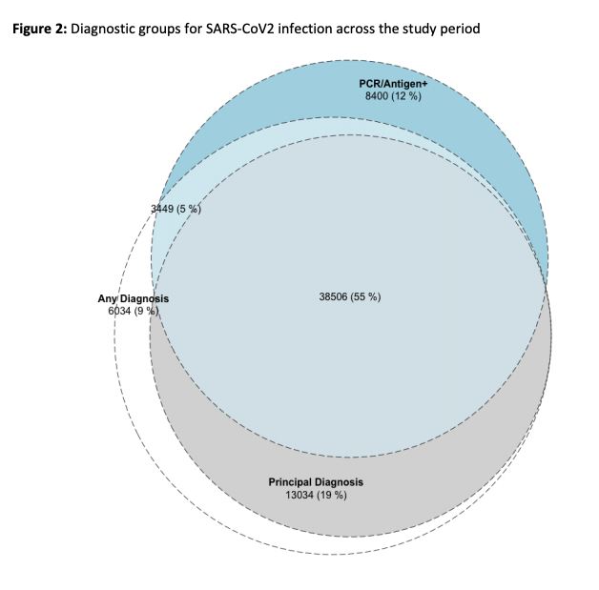
Example figure
HRF
ABG PaCO2 45+
Vent. Proc Code
ICD-10 Code

Slide 38
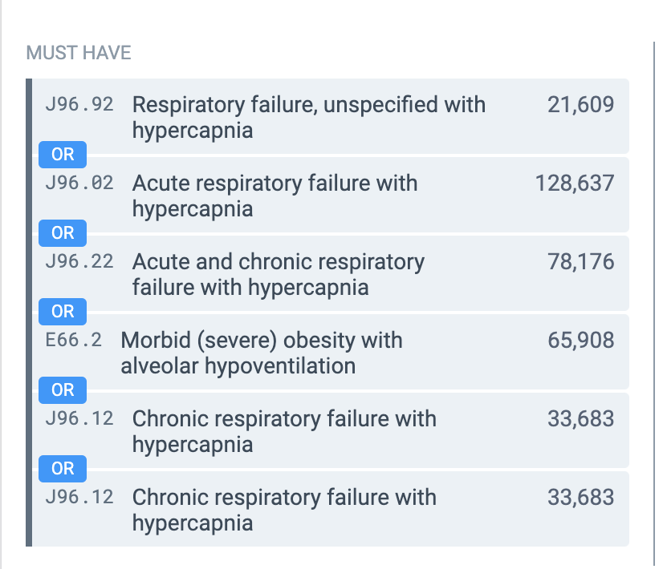
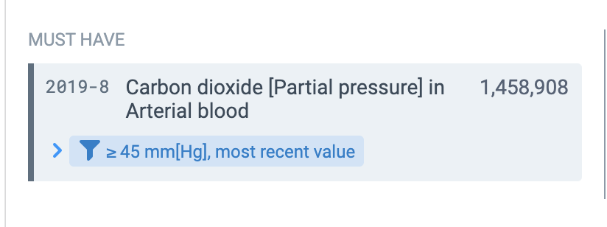
Preliminary analysis (in aggregate, without data control, only addressing hypothesis 2)

Slide 39
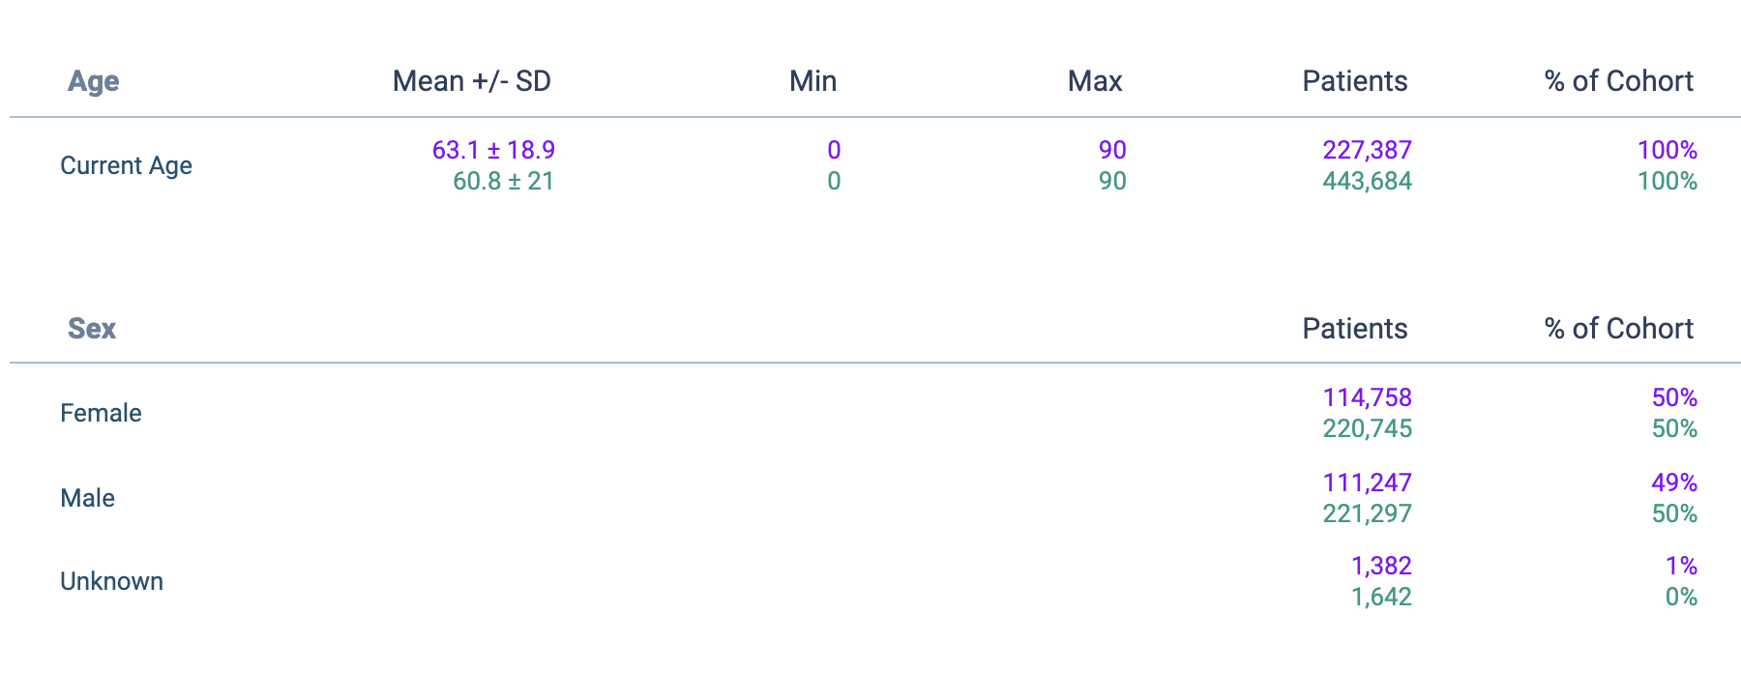
Demographics – older get labels

Slide 40
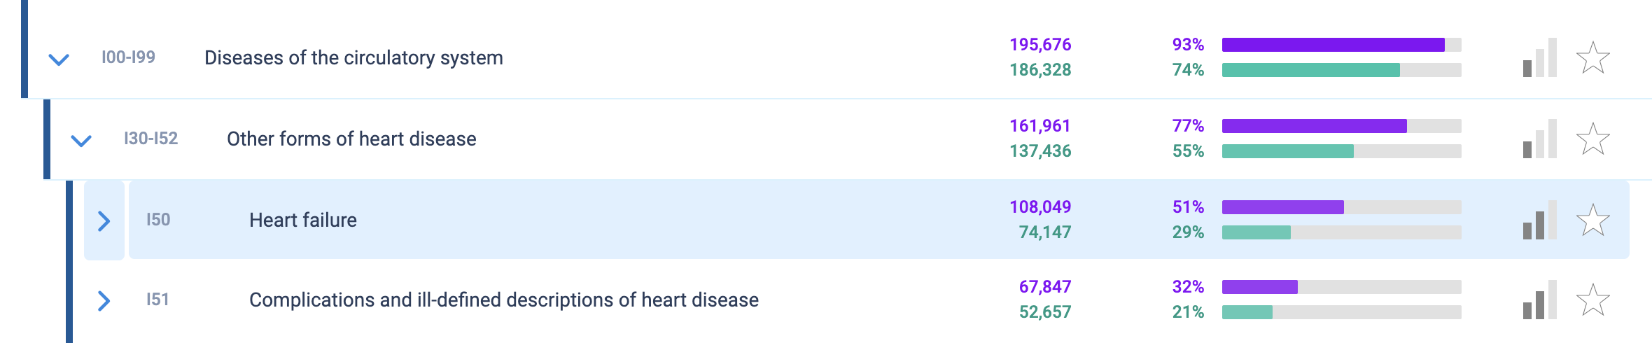
Heart Disease – more common in those labeled… and very common overall
Conditional probabilities:
P (Hypercapnic Resp Failure | Condition) = P ( HRF and condition) / P (Condition)

Slide 41
BMI – appears heavier patients are more likely to be labeled

Slide 42
Bicarbonate (adaptation/chronicity) - similar

Slide 43

Ventilation

Slide 44
Strengths
Not PHI: speed of the project
Broadly representative database
Large enough sample size that we can restrict analysis and maintain sufficient power
Demonstrates a very high frequency of CHF in folks who are diagnosed with hypercapnia by any measure
Notes:
[ ] Strengths:
Broadly representative
Data in aggregate makes the small variations less likely to make a difference to our conclusions

Slide 45
Anticipated challenges
Data completeness
U of U does not submit blood gasses. Other variations at other sites?
No PaCO2 over 45 mmHg
Could be it was never checked
Could be it was checked and <45
Could be it was checked and >45 but not uploaded
Plan: restrict an analysis to only patients who have a blood gas with any PaCO2
Example Calculation | ICD code = ‘Prediction’ | ICD code = ‘Prediction’
Blood gas = reference standard |  | ICD Code for Hypercapnic RF | No ICD code for Hypercapnic RF
Blood gas = reference standard | PaCO2 >= 45mmHg | True Positive | False Negative | Sensitivity TP / (TP + FN)
 | PaCO2 < 45mmHg (or no ABG) | False Positive | True Negative [We will not have these] | Specificity TN / (TN + FP)
 |  | PPV TP / (TP + FP) | NPV TN / (TN + FN)
Notes:
[ ] Strengths:
Broadly representative
Data in aggregate makes the small variations less likely to make a difference to our conclusions

Slide 46
Anticipated challenges
Who, exactly, is the source population and what sampling effects distort the database?
How often is the same patient included multiple times?
How to handle patients receiving invasive mechanical ventilation?
Other iatrogenic hypercapnia?

Slide 47
PA_{O2} = (P_{atm} – P_{H2O}) * Fi_{O2} – (Pa_{CO2} / RQ) + Fi_{O2} * Pa_{CO2} * (1-RQ)/RQ
Normal A-a gradient? 4 + (0.25 * Age)
Critical PAO2 = paO2 + (Normal A-a gradient)
Notes:
Hypercapnia is largely iatrogenic: without supplemental oxygen, people with hypercapnia wouldn’t persist – especially if they had concomitant lung disease.
This also makes sense why these people might be so frail and prone to readmission… as your PaCO2 goes up, your buffer goes down. In fact, that’s probably why we’re evolved to hyperventilate with altitude. – called referred to as “ventilatory acclimatization” (92).
Lastly: PaCO2 increases exponentially as VE decreases linearly (think of CO2 clearance and how GFR is much more different th
Note: from Dempsey JAP 2020 Pulmonary Overnuilt?
“[in sharp contrast
to these maladaptive responses to exercise in the sojourner,
trained or untrained residents of high altitude have acquired a
markedly reduced chemosensitivity plus an enhanced pulmonary
diffusion capacity that allows them to protect their arterial
PO2 during exercise via a narrowed A-aDO2 without excessive
hyperventilation and dyspnea (23, 34, 117)];”
23 https://www.jci.org/articles/view/107497
34 https://www.sciencedirect.com/science/article/abs/pii/0034568772900527?via%3Dihub
117 https://journals.physiology.org/doi/full/10.1152/ajpregu.00725.2003

Slide 48
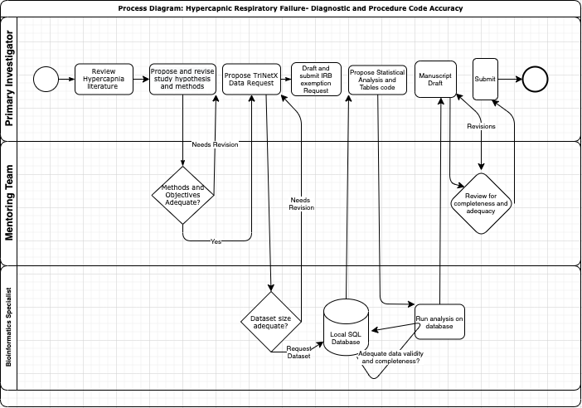
Next Steps
Data (~25 GB) pre-processing underway with Dr. Gouripeddi
Perform analysis and generate table/figures
Submit abstract for ATS (Due date end of October)

Slide 49
Implications:
Are prior studies interpretable? Comparable?
How should we define hypercapnic respiratory failure for the purposes of EHR-based studies?

Slide 50
Follow-up study
Computable Phenotype: pheno- , showing. –type, typology aka classification scheme -> Algorithm to classify patients based on available data
Notes:
Lilia Verchinina, PhD; Lisa Ferguson, MSI; Allen Flynn, PharmD; Michelle Wichorek, PhD; and Dorene Markel, MS, MHSA. “Computable Phenotypes: Standardized Ways to Classify People Using Electronic Health Record Data.” Perspectives in Health Information Management (Fall 2018): 1-8.

Slide 51

How might that be done?
Goal: accurately label patients based on a combination of blood gas, bicarbonate, medications, procedural codes, diagnostic codes.
Requires “reference standard” – this time, needs expert adjudication (ie. chart review)
A reference standard labeled cohort of patients with hypercapnic respiratory failure could also be be used for other studies.
What data source? Limitations to generalizability at 4500 ft and mostly white?
Chart Review
Notes:
The scream

Slide 52
Summary:
Patients with hypercapnic respiratory failure have high morbidity, mortality, and healthcare utilization; there is an opportunity for research to help improve their management.
On a population level not much is known about why they are hypercapnic, or what we should do to manage them. I think CHF/loop diuretics and OSA are more common contributors than generally realized.
Our first step: ground-work defining the population of interest for future studies based on the TrinetX dataset

Slide 53
Notes:
Acute Hypercapnia is well tolerated… but the impact is in determining the cause of hypercapnia, reversing it, and instituting changes so that it doesn’t happen again.

